Slide 1
NAME: RATHIKA.S REG.NO:24131210500122037 DEPARTMENT:BCA COLLEGE: IMMACULATE COLLEGE FOR WOMEN
Student portfolio

Slide 2
AGENDA
Problem statement
Project overview
End users
Tools and technologies
Portfolio design and layout
Features and functionality
Result and screenshots
Conclusion
GitHub link

Slide 3
PROBLEM STATEMENT
A problem statement is a concise and formal summary that defines a specific issue a team or organization needs to address, identifying the gap between a current undesirable state and a desired future goal.
It provides context, clearly states the problem, and explains its importance and impact, serving as a guide for the problem-solving process without detailing the solution itself.

Slide 4
PROJECT OVERVIEW
A project overview is a concise, one-page summary of a project’s essential information, including its problem or opportunity, goals, objectives, timeline, resources, and key stakeholders.
Its purpose is to provide a high-level, easily digestible understanding of the project to clients, team members, and management, ensuring everyone is aligned and to secure buy-in or funding.

Slide 5
END USERS
An end user is the person or entity that ultimately uses or consumes a product, service, or system, rather than the person who purchases it.
While a customer buys a product, an end user is the one who directly interacts with it and benefits from its functionality.

Slide 6
TOOLS AND TECHNOLOGIES
Tools are specific, often tangible objects, or software that extend human capabilities to perform tasks more easily, precisely, or efficiently, like a hammer or a word processor.
Technologies are broader systems, methods, or a coordinated collection of tools and scientific knowledge applied to solve problems and achieve practical goals in a reproducible way, such as the internet or the wheel.

Slide 7
PORTFOLIO DESIGN AND LAYOUT
Portfolio design is the strategic process of selecting, organizing, and presenting your best work to showcase your skills, process, and personal brand to potential employers or clients.
Portfolio layout refers to the visual arrangement of these elements within a digital or physical space, using grids and visual hierarchy to create a professional, readable, and compelling presentation that effectively communicates your unique value and design capabilities.

Slide 8
FEATURES AND FUNCTIONALITY
Features are the specific components, characteristics, or attributes of a product or service, such as a “camera” on a smartphone or “custom leave types” in software.
Functionality refers to the broader actions and capabilities a product can perform, utilizing its features to fulfill user needs

Slide 9
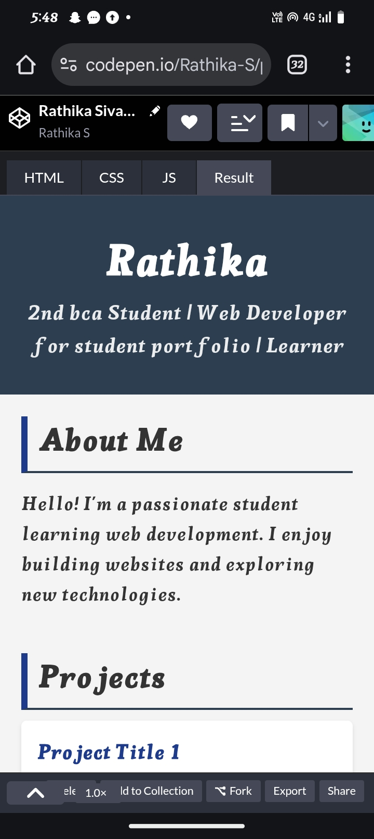
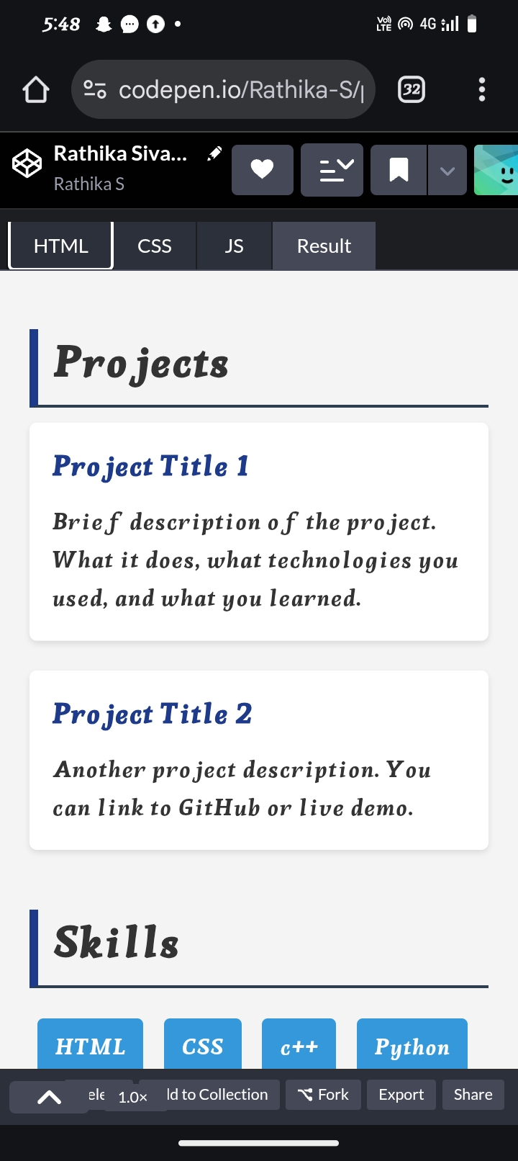
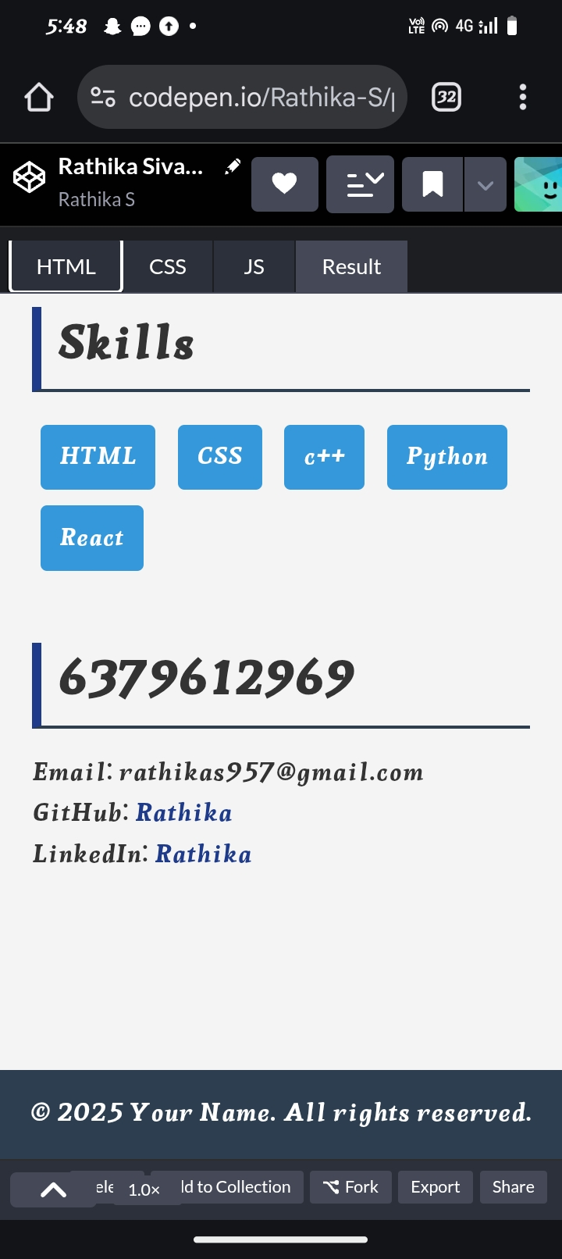
RESULT AND SCREENSHOT

Slide 10
CONCLUSION
A portfolio is a compilation of academic and professional materials that exemplifies your beliefs, skills, qualifications, education, training, and experiences.

Slide 11
THANK YOU

